Slide 1
机器人与人工智能实验室 Robotics and Artificial Intelligence Laboratory
WELCOME TO

Slide 2
On-Chip EEPROM
1. Introduction
Separate the read and write operations by two programs. One program writes data and the other program reads data. Because we need to test whether the data is still there after power is turned off.
Data can only be read after the power is turned off, not written and then read.

Slide 3
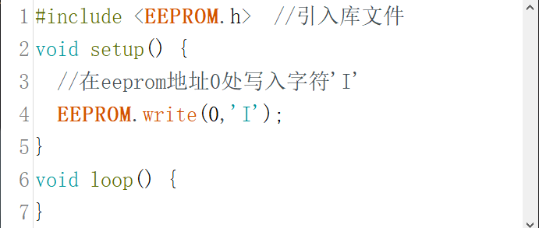
On-Chip EEPROM
2. Coding

Slide 4
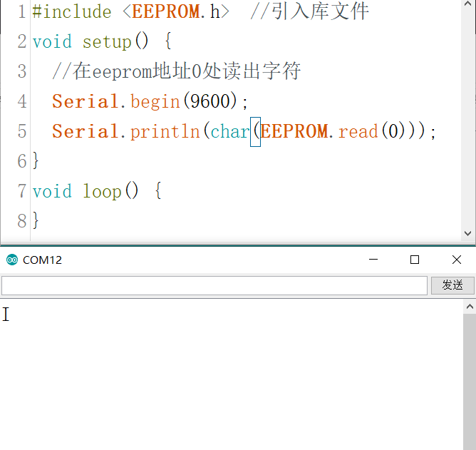
On-Chip EEPROM
Next (Reading):

Slide 5

On-Chip EEPROM
To write a byte type here, change I to byte variable or numeric constant.
EEPROM can only store one byte of data at a time.
(a) To store int type variables (accounting for two bytes), we need to write a function:

Slide 6

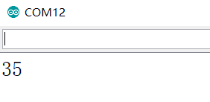
On-Chip EEPROM
(b) Read the byte data and output it to the serial port.
(c) Open the serial monitor for the result.

Slide 7

THANK YOU
林天麟 教授
香港中文大学（深圳）
机器人与人工智能实验室
WeChat: tinlunlam

